Slide 1

Machine learning course
Presented by Abdel Rahman AlSabbagh
Lecture #5 – WED – 24.5.2023

Slide 2


Tech Requirements
In the name of Allah, the most gracious, the most merciful, we start :)
Machine Learning Course
Abdel Rahman AlSabbagh

Slide 3
Tech Requirements
Today’s Quote
“Start by doing what’s necessary; then do what’s possible; and suddenly you are doing the impossible”
- Francis of Assisi
Machine Learning Course
Abdel Rahman AlSabbagh

Slide 4
Tech Requirements
Artificial Neural Networks
ANNs.
Tensorflow/Keras.
Forward propagation.
Activcation functions.
Source: Machine Learning Specialization by Andrew Ng and Stanford Online.
Machine Learning Course
Abdel Rahman AlSabbagh

Slide 5
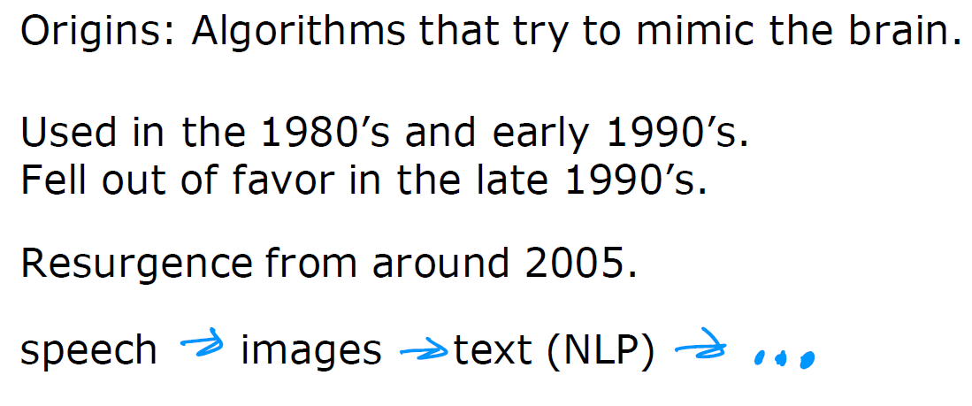
Tech Requirements
Artificial Neural Networks
Machine Learning Course
Abdel Rahman AlSabbagh

Slide 6
Tech Requirements
Neural Networks
Machine Learning Course
Abdel Rahman AlSabbagh

Slide 7
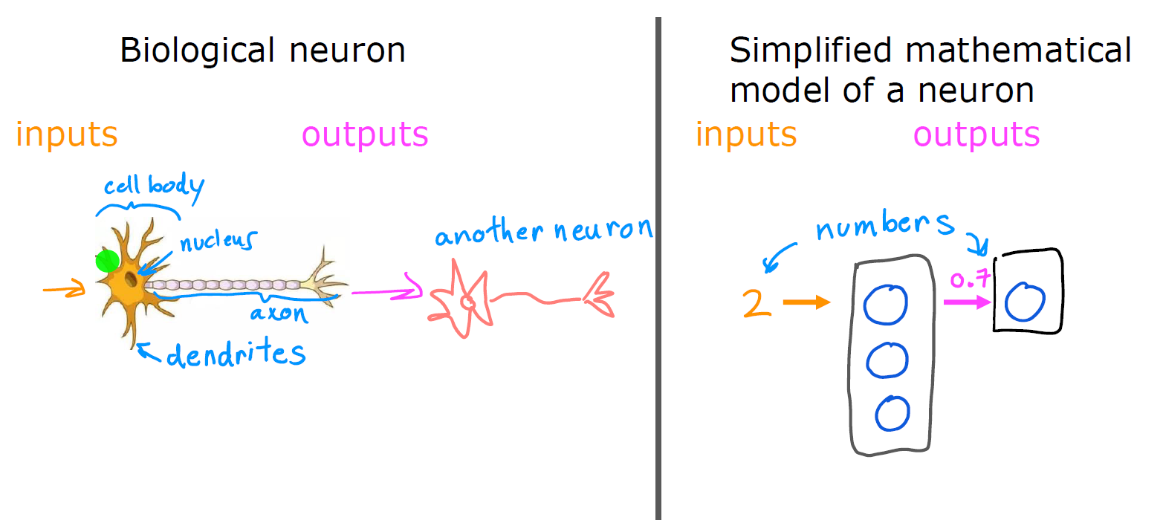
Tech Requirements
Neural Networks
Machine Learning Course
Abdel Rahman AlSabbagh

Slide 8
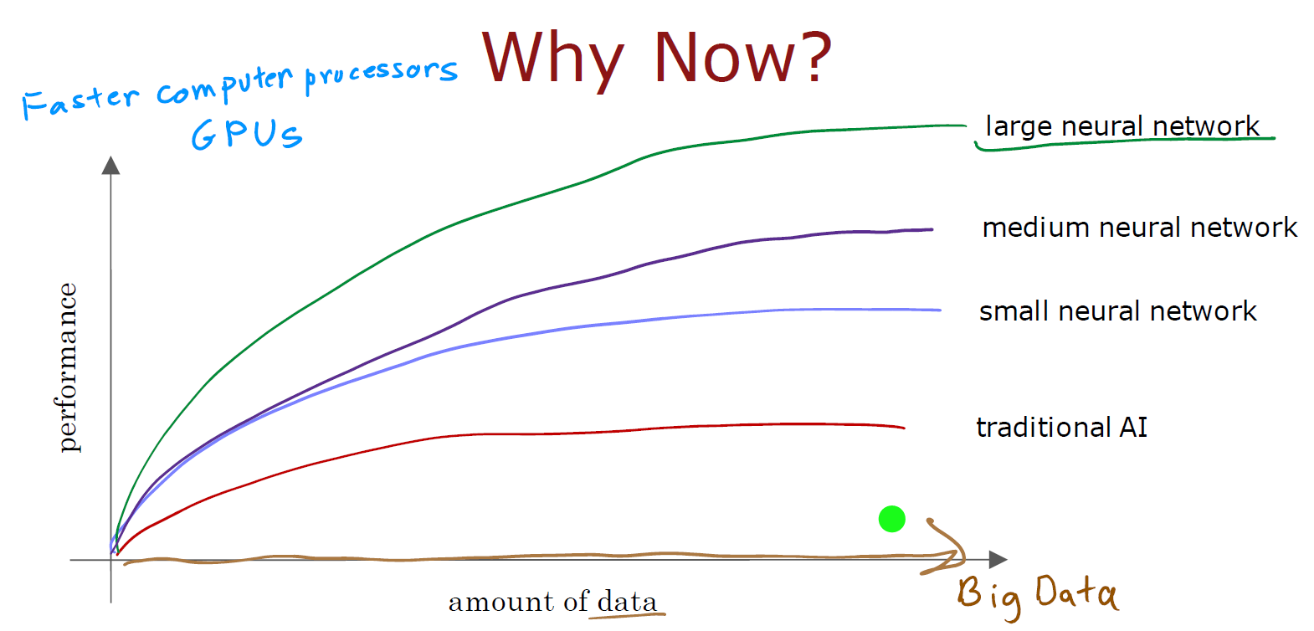

Tech Requirements
Why Now?
Machine Learning Course
Abdel Rahman AlSabbagh

Slide 9
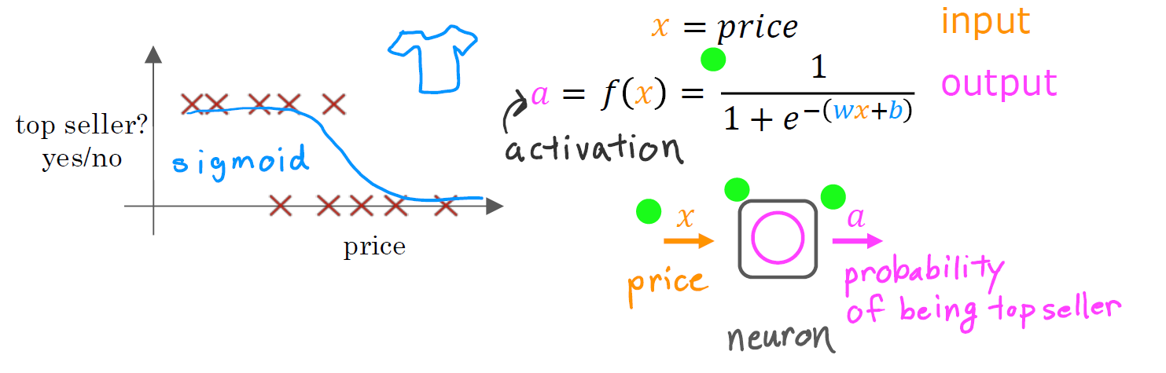
Tech Requirements
Demand Prediction
Machine Learning Course
Abdel Rahman AlSabbagh

Slide 10
Tech Requirements
Demand Prediction
Machine Learning Course
Abdel Rahman AlSabbagh

Slide 11
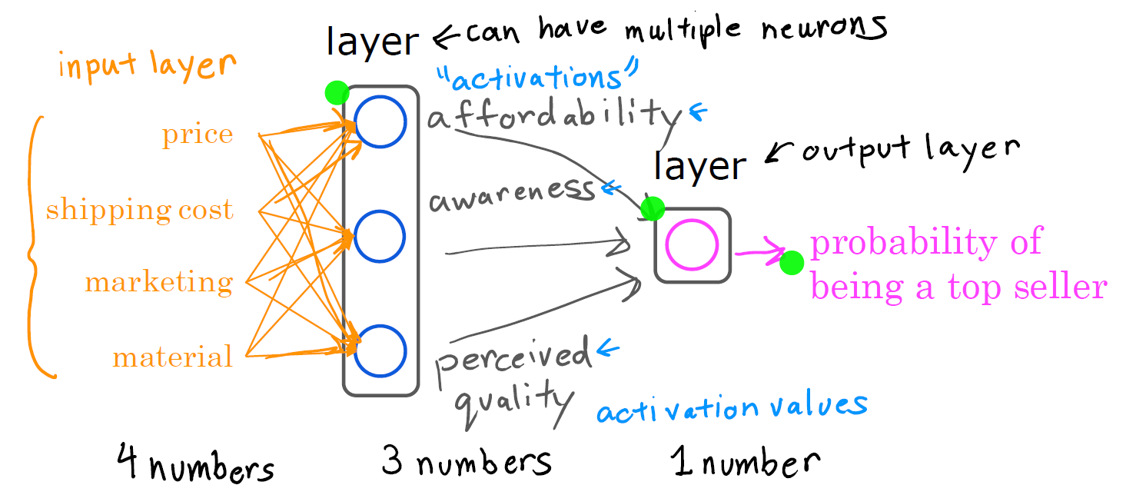
Tech Requirements
Demand Prediction
Machine Learning Course
Abdel Rahman AlSabbagh

Slide 12
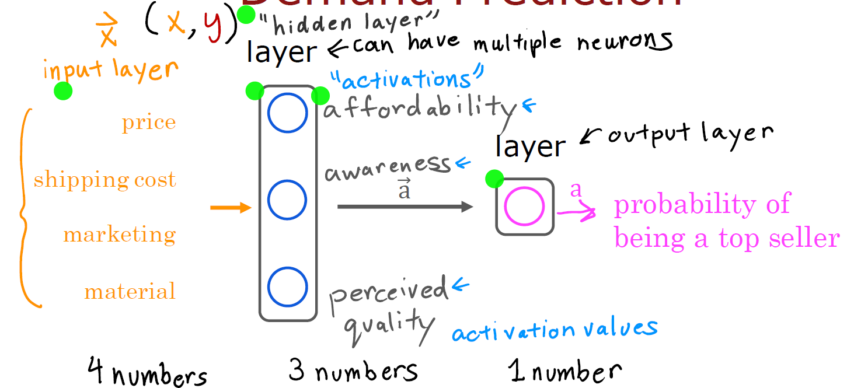
Tech Requirements
Demand Prediction
Machine Learning Course
Abdel Rahman AlSabbagh

Slide 13
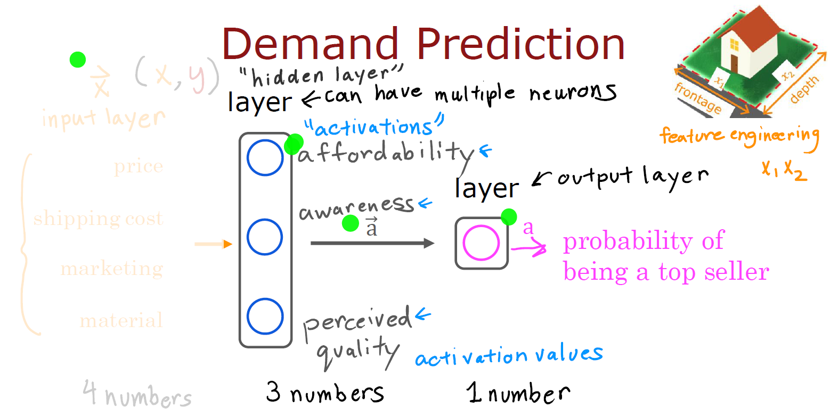
Tech Requirements
Demand Prediction
Machine Learning Course
Abdel Rahman AlSabbagh

Slide 14
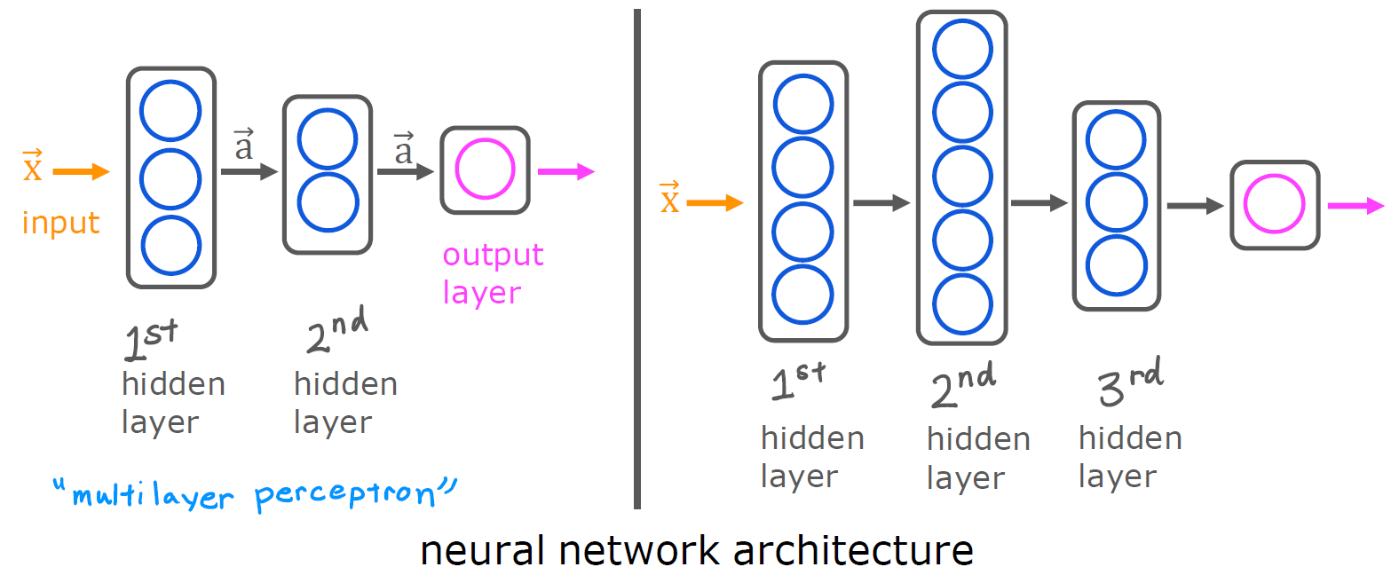
Tech Requirements
Multiple Hidden Layers
Machine Learning Course
Abdel Rahman AlSabbagh

Slide 15
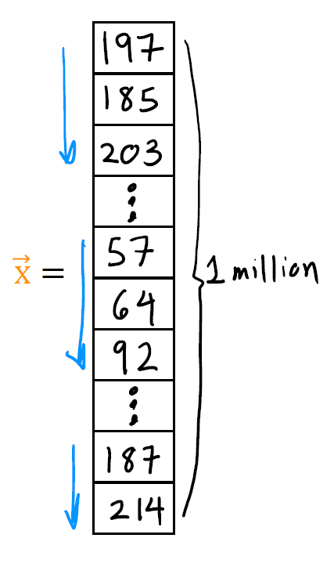
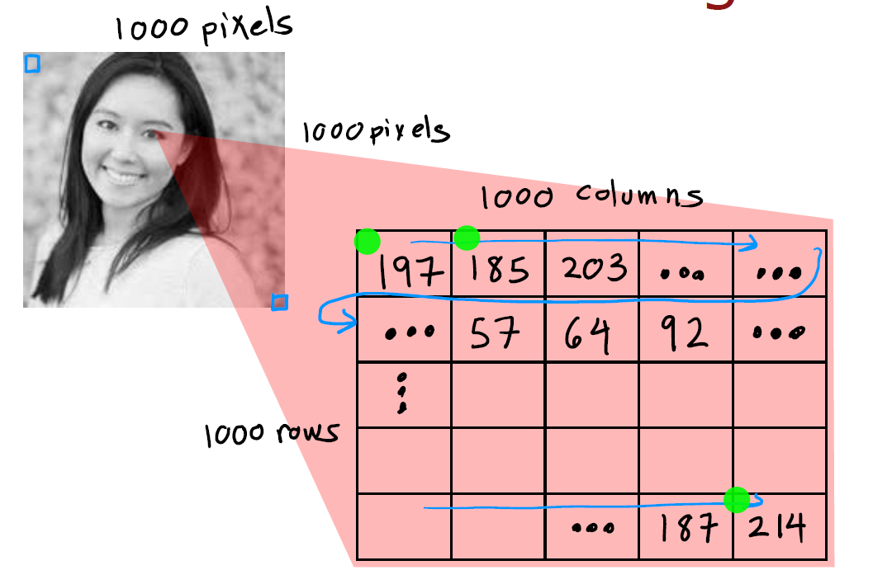
Tech Requirements
Face Recognition
Machine Learning Course
Abdel Rahman AlSabbagh

Slide 16
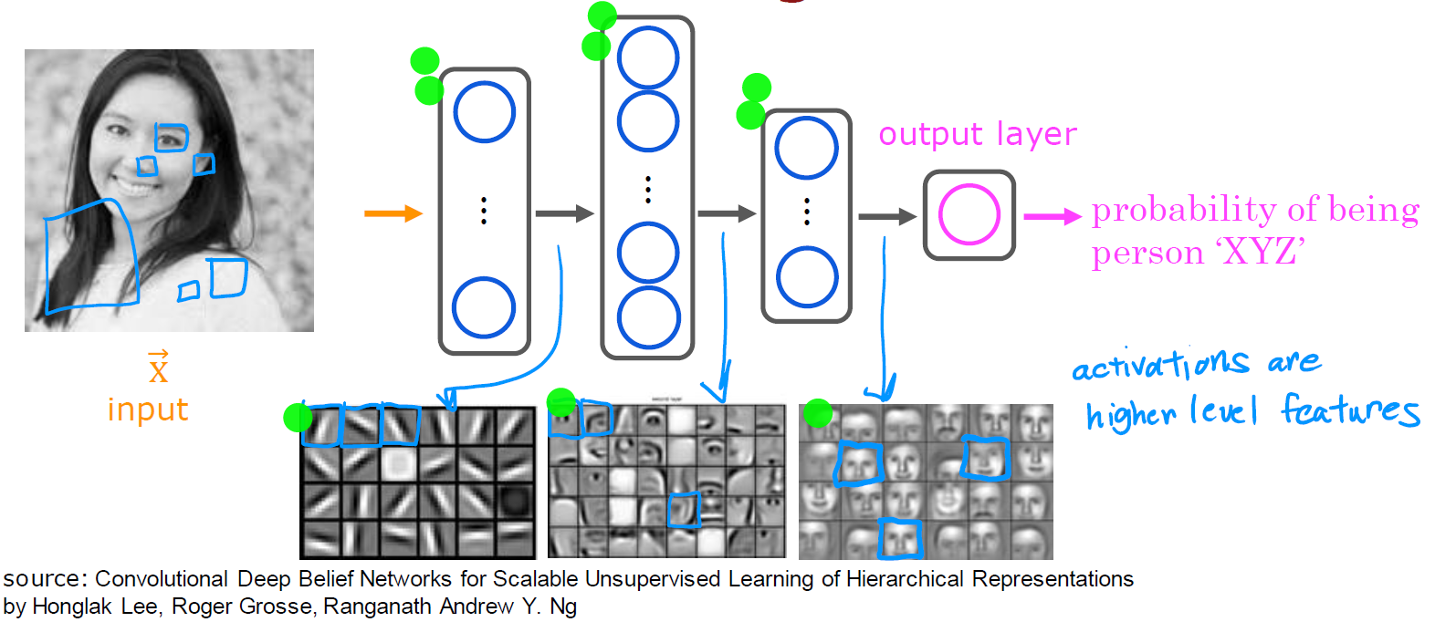
Tech Requirements
Face Recognition
Machine Learning Course
Abdel Rahman AlSabbagh

Slide 17
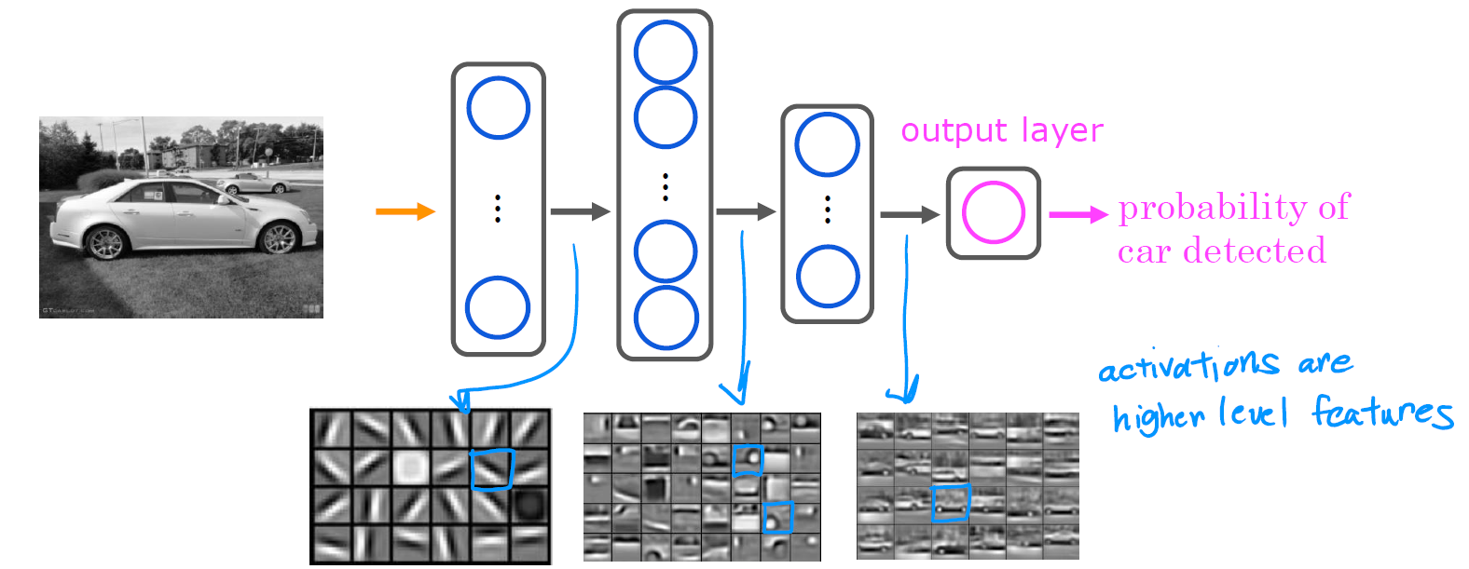
Tech Requirements
Car Classification
Machine Learning Course
Abdel Rahman AlSabbagh

Slide 18
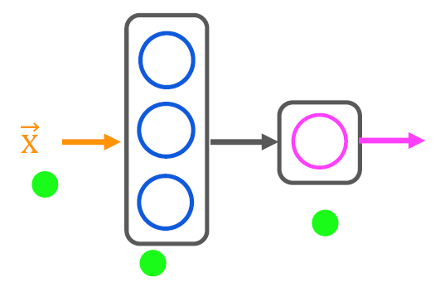

Tech Requirements
Neural Network Layer
Machine Learning Course
Abdel Rahman AlSabbagh

Slide 19
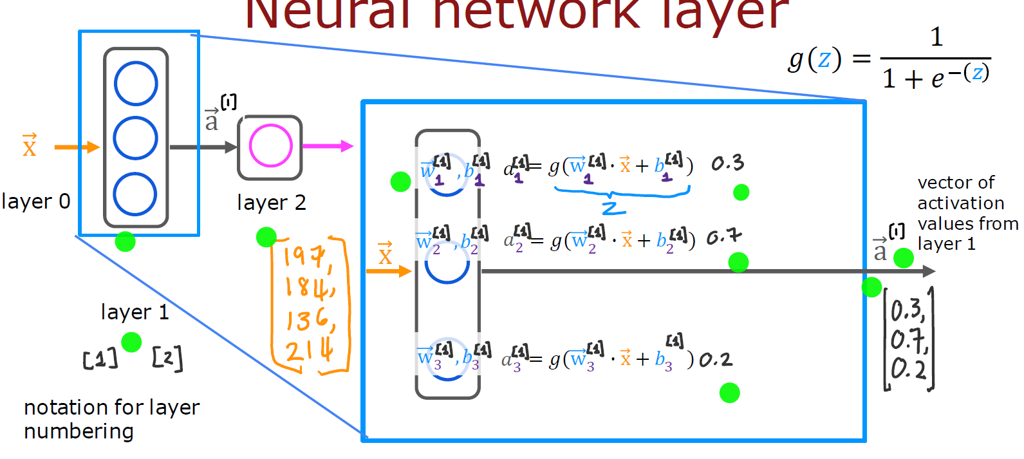
Tech Requirements
Neural Network Layer
Machine Learning Course
Abdel Rahman AlSabbagh

Slide 20
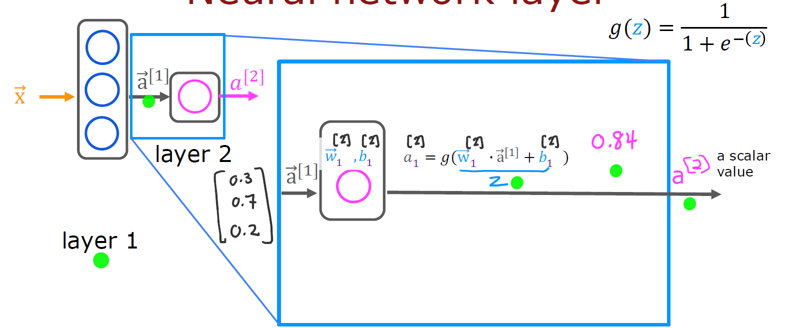
Neural Network Layer
Machine Learning Course
Abdel Rahman AlSabbagh

Slide 21
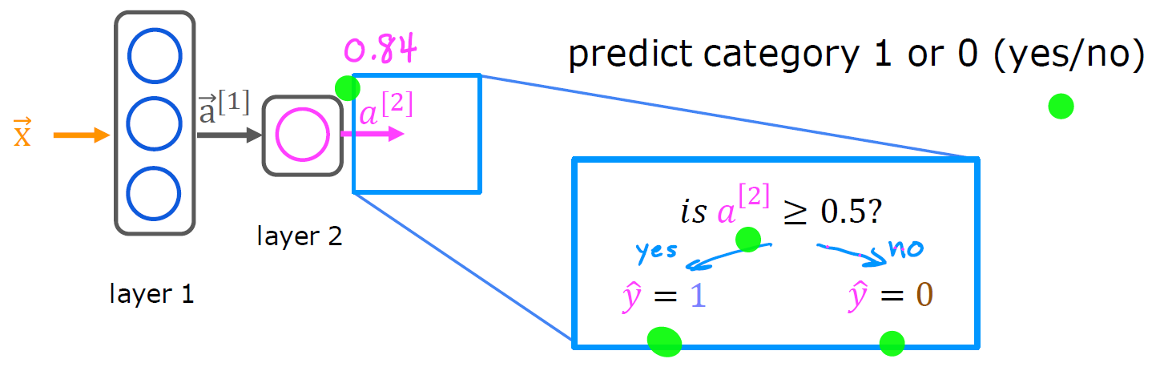
Neural Network Layer
Machine Learning Course
Abdel Rahman AlSabbagh

Slide 22
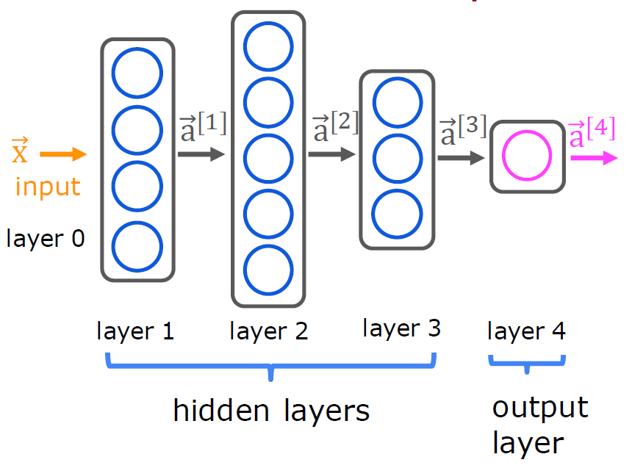
More Complex Neural Network
Machine Learning Course
Abdel Rahman AlSabbagh

Slide 23
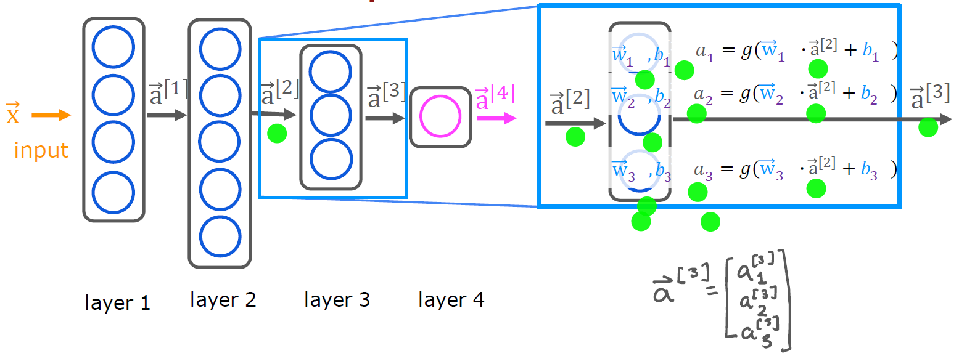
More Complex Neural Network
Machine Learning Course
Abdel Rahman AlSabbagh

Slide 24

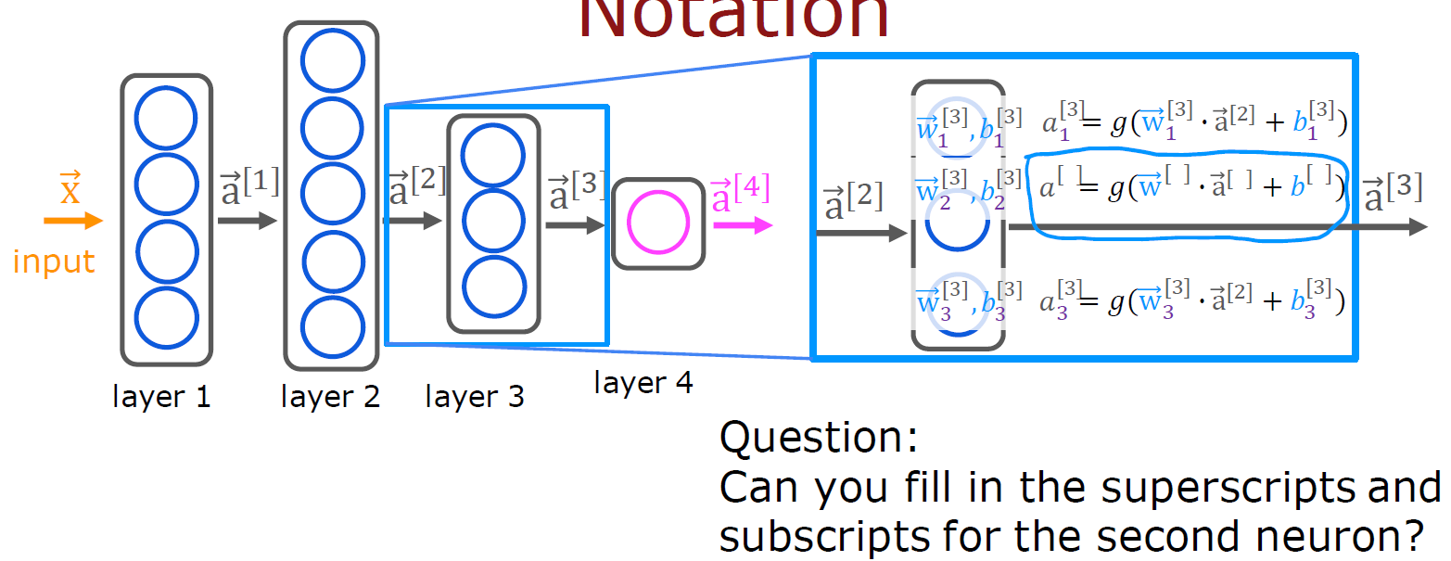
More Complex Neural Network
Machine Learning Course
Abdel Rahman AlSabbagh

Slide 25

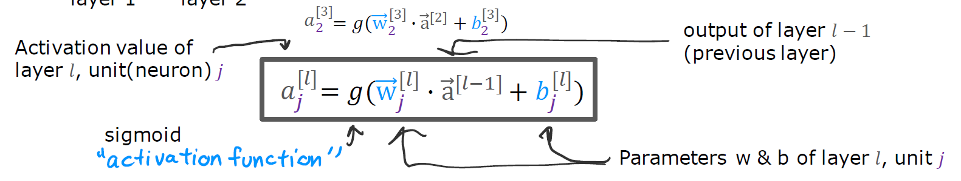
More Complex Neural Network
Machine Learning Course
Abdel Rahman AlSabbagh

Slide 26
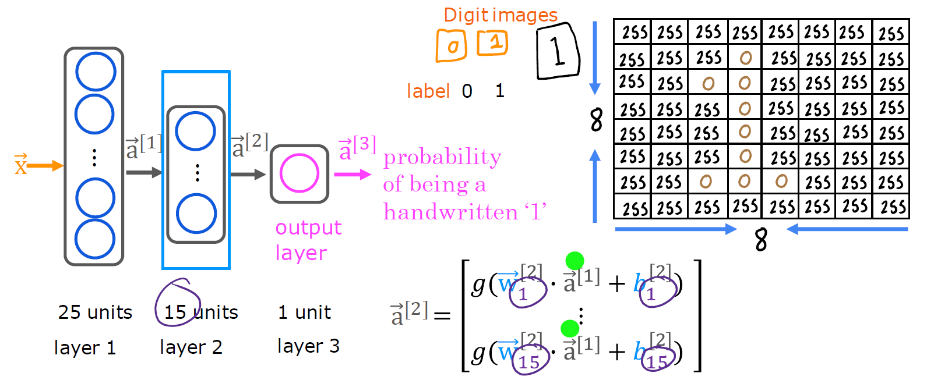
Handwritten Digit Recognition
Machine Learning Course
Abdel Rahman AlSabbagh

Slide 27
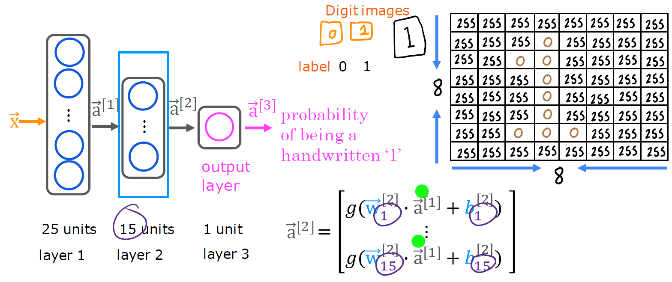
Handwritten Digit Recognition
Machine Learning Course
Abdel Rahman AlSabbagh

Slide 28
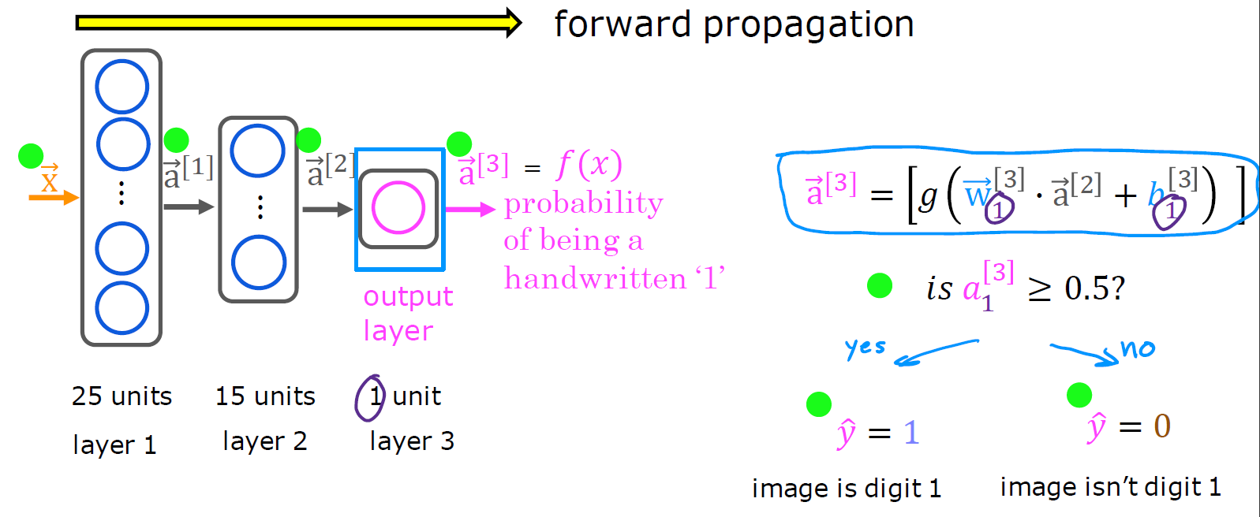
Forward Propagation
Machine Learning Course
Abdel Rahman AlSabbagh

Slide 29
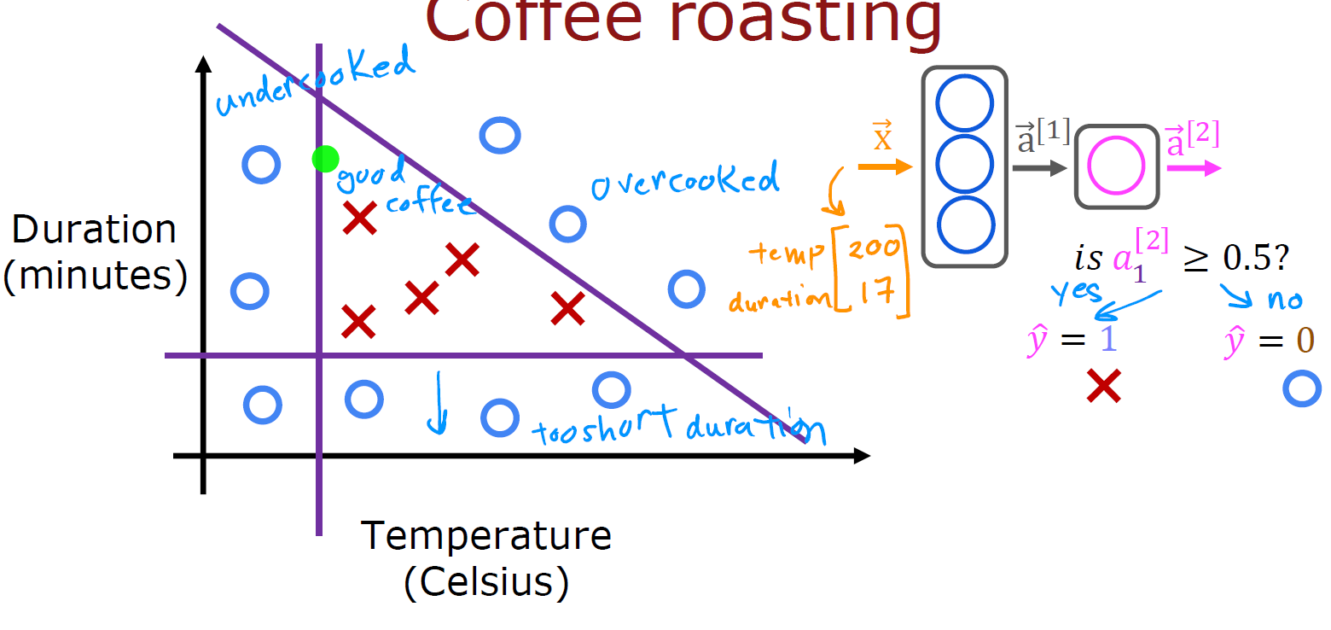
Code Example
Machine Learning Course
Abdel Rahman AlSabbagh

Slide 30
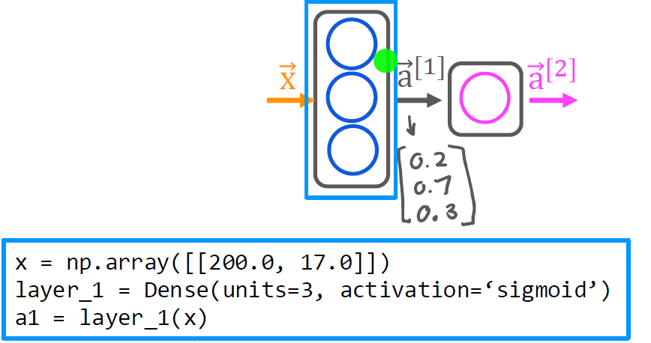
Build The Model Using TensorFlow/Keras
Machine Learning Course
Abdel Rahman AlSabbagh

Slide 31
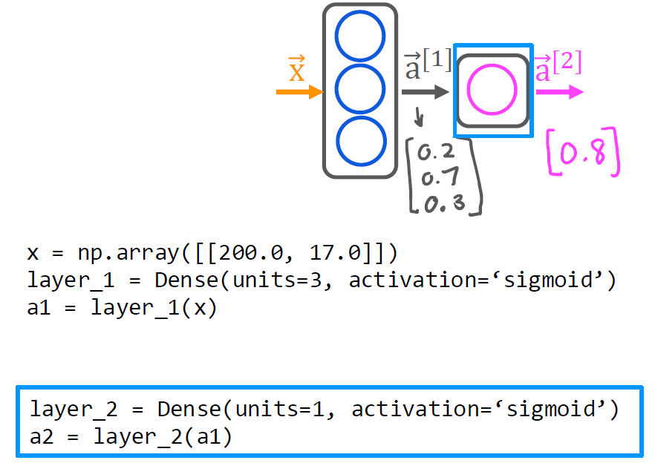
Build The Model Using TensorFlow/Keras
Machine Learning Course
Abdel Rahman AlSabbagh

Slide 32
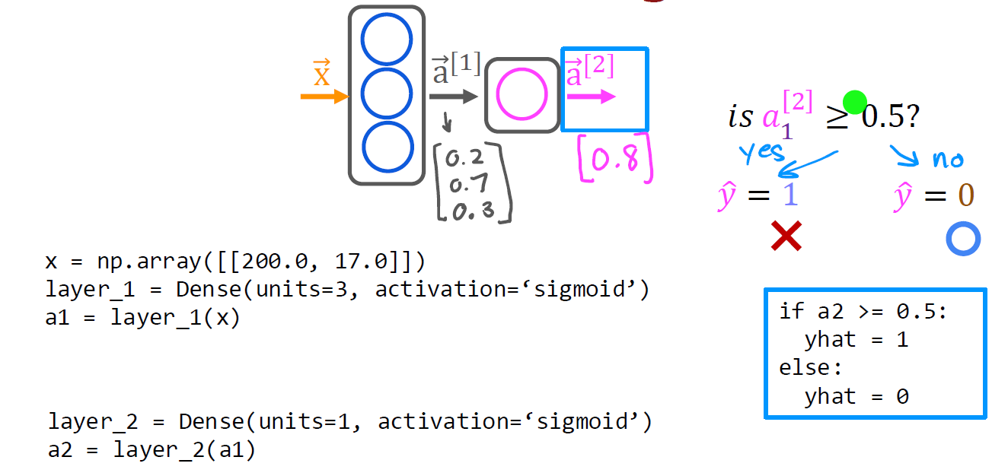
Build The Model Using TensorFlow/Keras
Machine Learning Course
Abdel Rahman AlSabbagh

Slide 33
Build The Model Using TensorFlow/Keras
Machine Learning Course
Abdel Rahman AlSabbagh

Slide 34
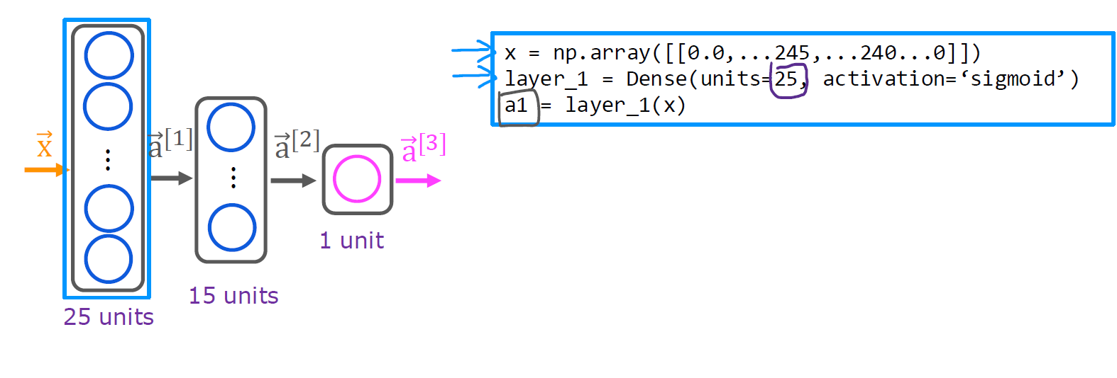
Build The Model Using TensorFlow/Keras
Machine Learning Course
Abdel Rahman AlSabbagh

Slide 35
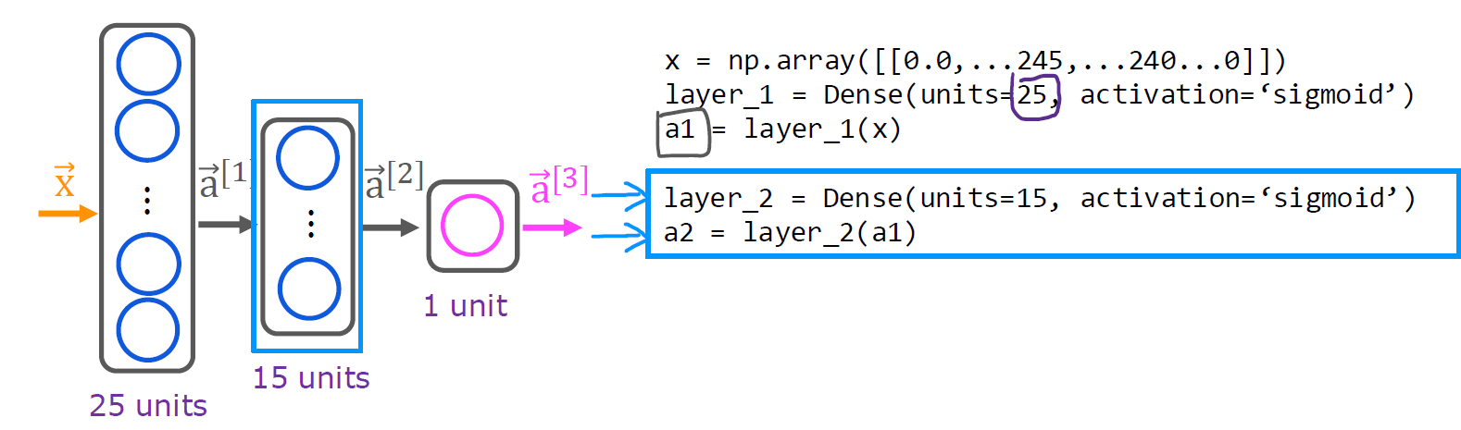
Build The Model Using TensorFlow/Keras
Machine Learning Course
Abdel Rahman AlSabbagh

Slide 36
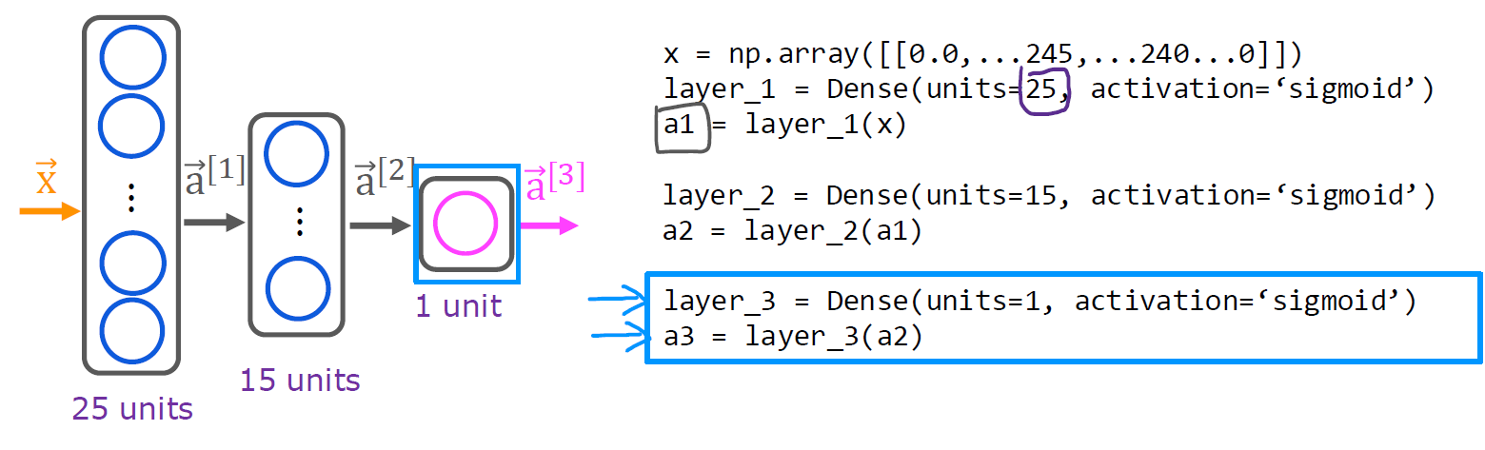
Build The Model Using TensorFlow/Keras
Machine Learning Course
Abdel Rahman AlSabbagh

Slide 37
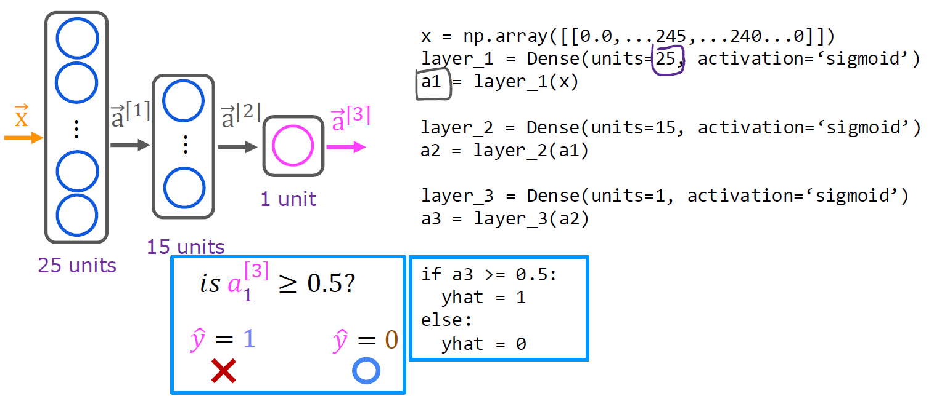
Build The Model Using TensorFlow/Keras
Machine Learning Course
Abdel Rahman AlSabbagh

Slide 38
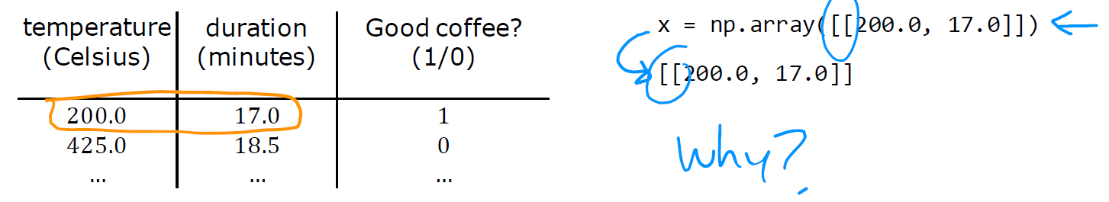
Data in TensorFlow/Keras
Machine Learning Course
Abdel Rahman AlSabbagh

Slide 39
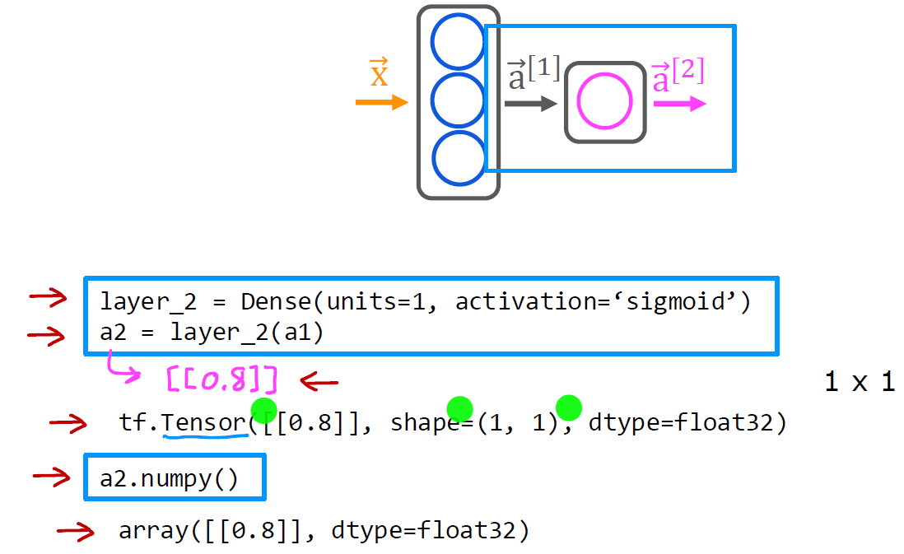
Data in TensorFlow/Keras
Machine Learning Course
Abdel Rahman AlSabbagh

Slide 40
Activation Vectors
Machine Learning Course
Abdel Rahman AlSabbagh

Slide 41
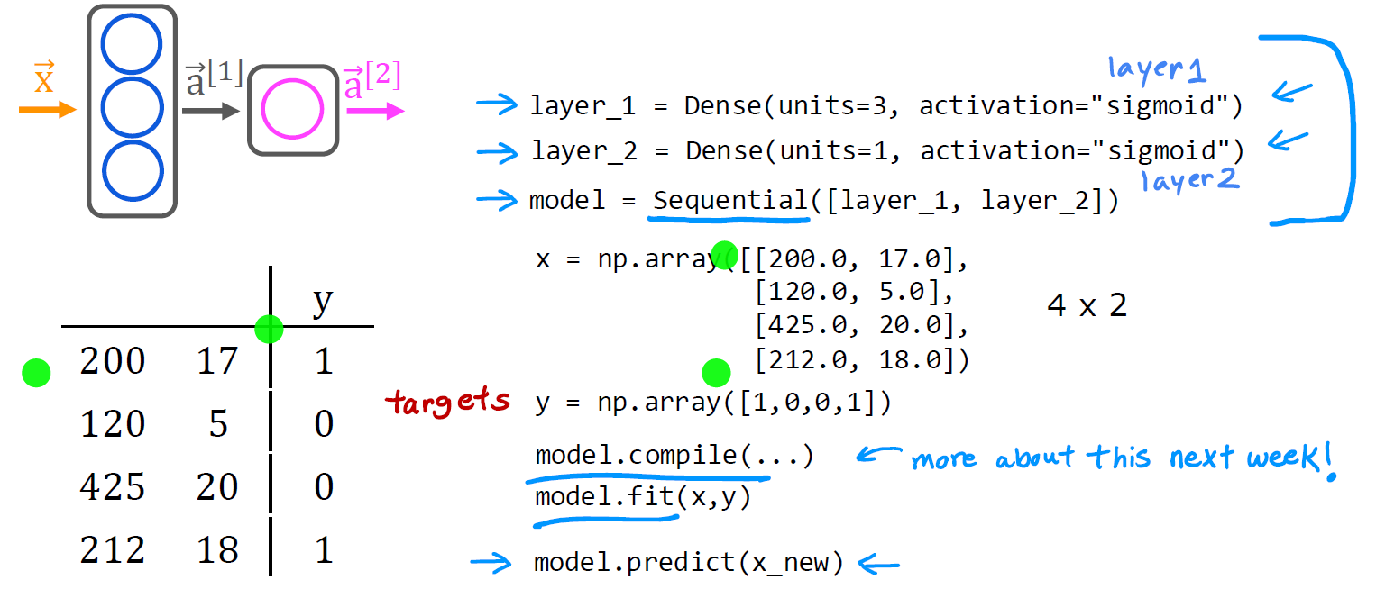
Building a Neural Network
Machine Learning Course
Abdel Rahman AlSabbagh

Slide 42
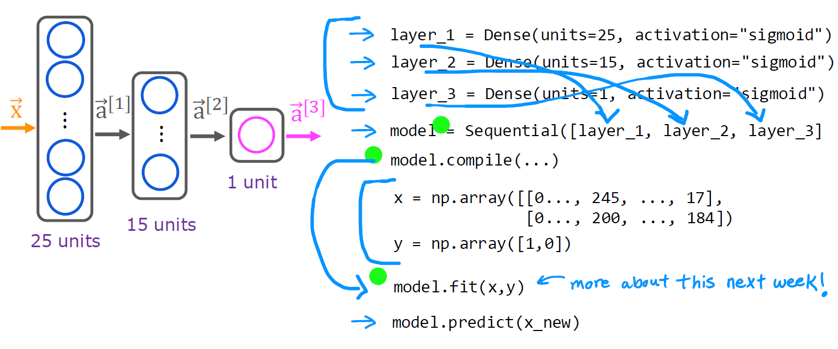
Building a Neural Network
Machine Learning Course
Abdel Rahman AlSabbagh

Slide 43
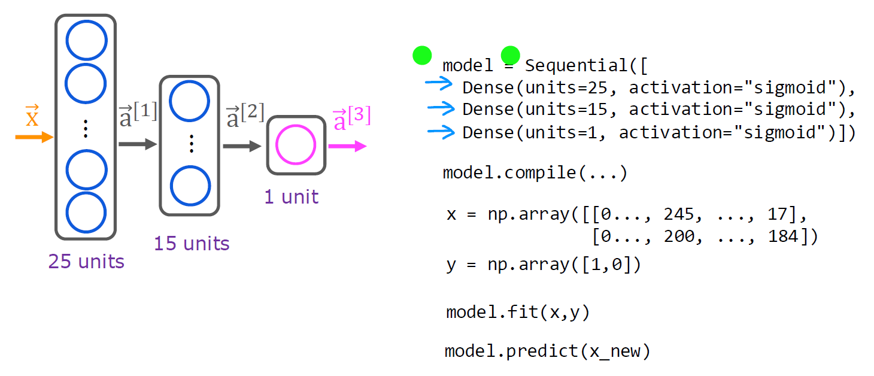
Building a Neural Network
Machine Learning Course
Abdel Rahman AlSabbagh

Slide 44
Building a Neural Network
Machine Learning Course
Abdel Rahman AlSabbagh

Slide 45
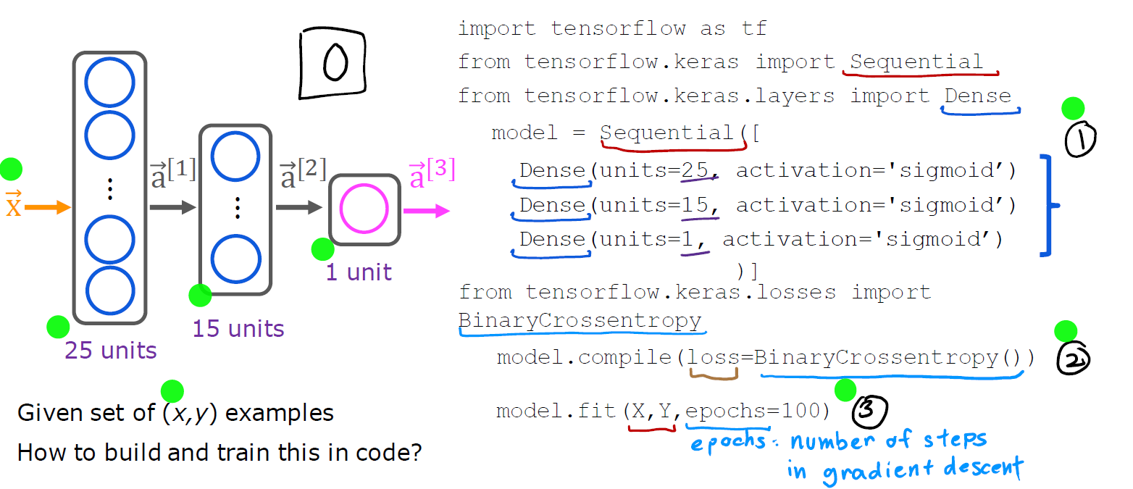
Building a Neural Network – Details
Machine Learning Course
Abdel Rahman AlSabbagh

Slide 46
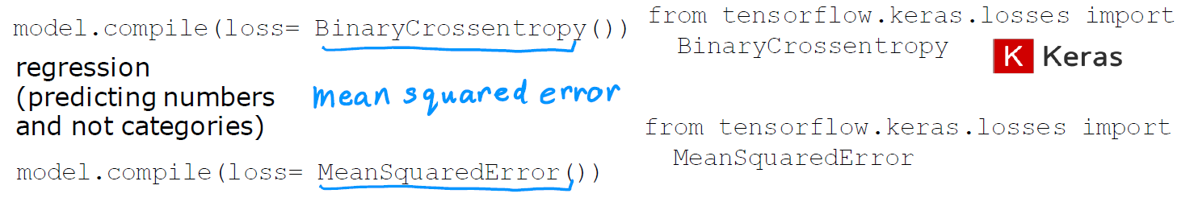

Building a Neural Network – Details
Machine Learning Course
Abdel Rahman AlSabbagh

Slide 47
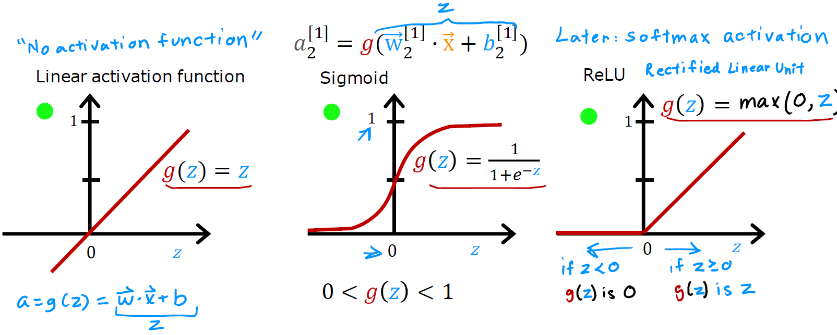
Activation Functions
Machine Learning Course
Abdel Rahman AlSabbagh

Slide 48
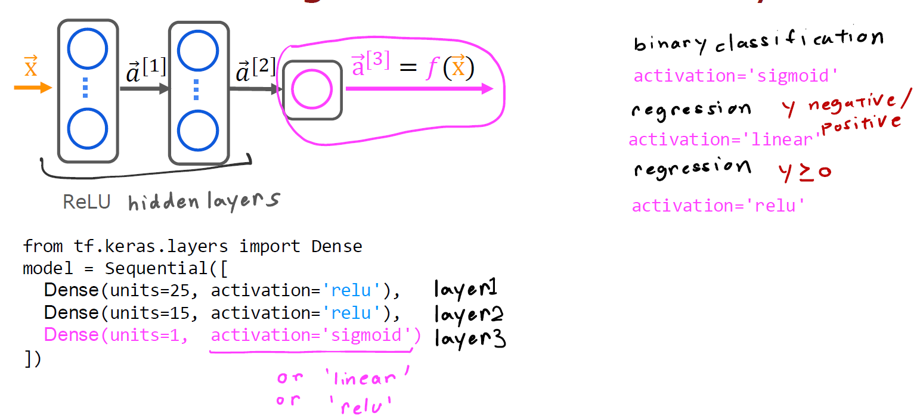
Activation Functions
Machine Learning Course
Abdel Rahman AlSabbagh

Slide 49
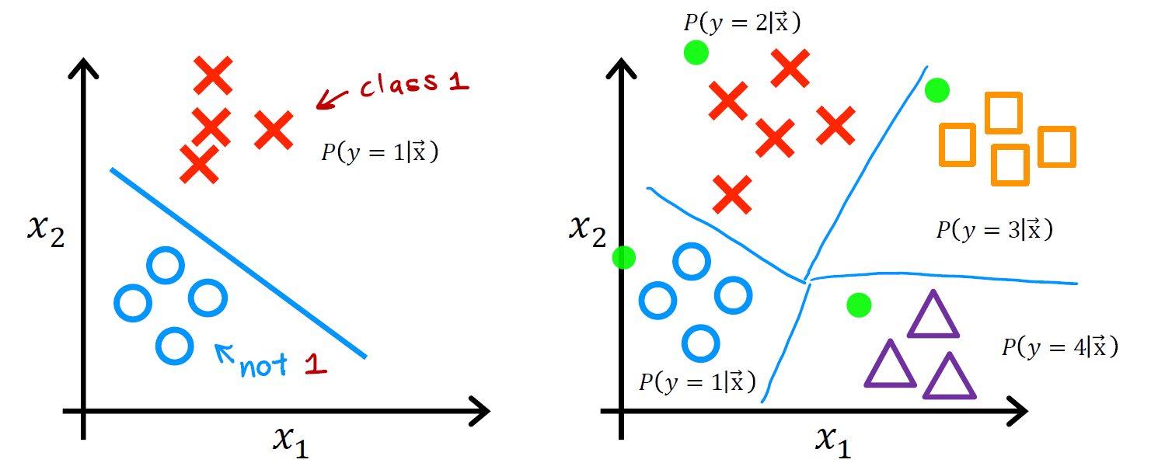
Multiclass Classification
Machine Learning Course
Abdel Rahman AlSabbagh

Slide 50
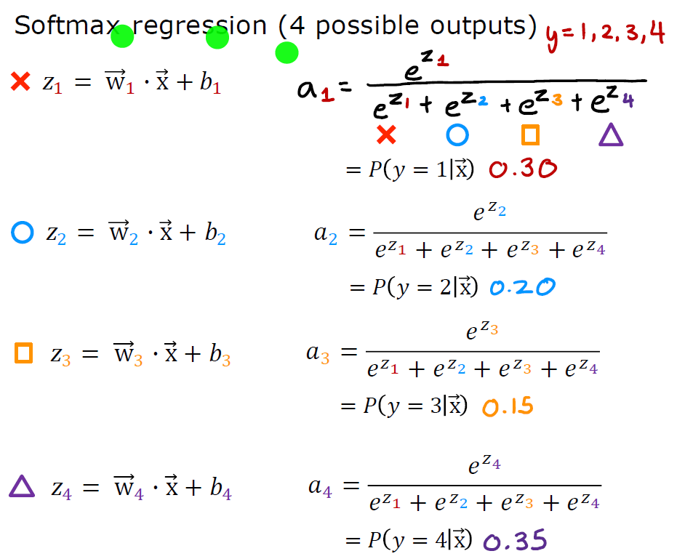
Multiclass Classification
Machine Learning Course
Abdel Rahman AlSabbagh

Slide 51
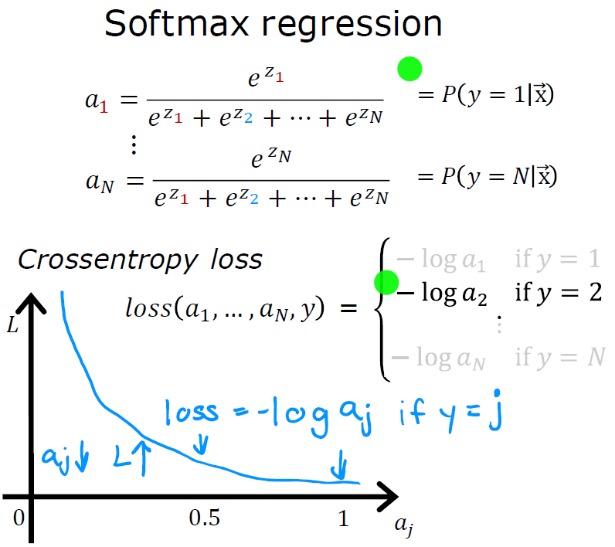
Multiclass Classification
Machine Learning Course
Abdel Rahman AlSabbagh

Slide 52
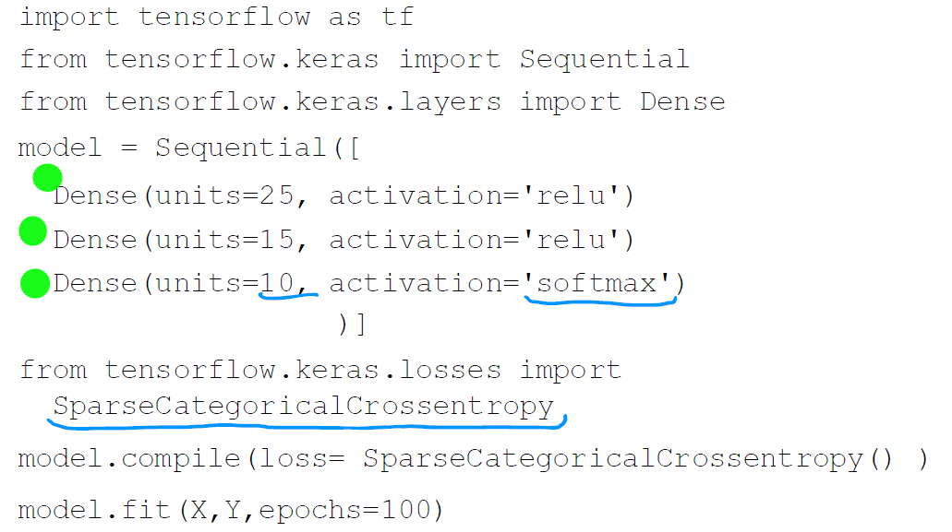
Multiclass Classification
Machine Learning Course
Abdel Rahman AlSabbagh

Slide 53


Thank You
Next lecture will be online on sat, 27.5.2023, In Shaa allah!
sabbagh@ieee.org
Connect on Linkedin

